Slide 1
CONSUMER BEHAVIOUR PRESENTATION
ON
DIFFUSION OF INNOVATION

Slide 2
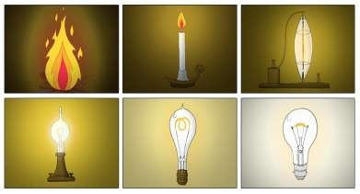
What is Innovation???
Transformation of an idea into something useful.
There are two different kinds of innovations
New things
Development of new things.

Slide 3
Diffusion of Innovation
The diffusion of innovations theory seeks to explain how and why new ideas and practices are adopted, with timelines potentially spread out over long periods.
It is designed in two process:
Diffusion
Adoption

Slide 4
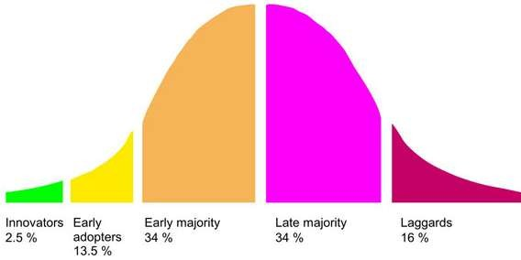
Stages in innovation
Innovators
Early adopters
Early majority
Late majority
Laggards.

Slide 5
The diffusion process
The innovation | Various approaches have been taken to define new product: Firm oriented Product oriented Market oriented Consumer oriented
The channels of communication
The social system
Time

Slide 6
The diffusion process
The innovation | how quickly innovation spread depends on channel on communication. There are two sources for communication: Impersonal Interpersonal
The social system
Time

Slide 7
The diffusion process
The innovation | It is a physical, social or cultural environment in which people belong and within which they function: It can be of two type : Traditional social system Modern social system
The channels of communication
Time

Slide 8
The diffusion process
The innovation | Backbone of diffusion process. it pervades the study of diffusion in three distinct ways : The amount of purchase time. The identification of adopter categories The rate of adoption.
The channels of communication
The social system

Slide 9
Product characteristics that influence diffusion
Relative advantage
Compatibility
Complexity
Trialability
Observability
Resistance to innovation

Slide 10
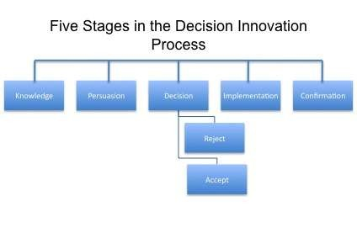
Stages in adoption

Slide 11
Adoption process
 | Consumer in first expose to the product innovation. Lacks in information about the product May only know the name of product and its basic features.
Interest
Evaluation
Trial
Adoption or Rejection

Slide 12
Adoption process
Awareness | Consumer is interested in product and search for additional information. He wants to know what is it, how it works and what its potentialities are.
Evaluation
Trial
Adoption or Rejection

Slide 13
Adoption process
Awareness | Consumer decides whether or not to believe this product or service. Will it satisfy his needs and requirements. Individual makes a mental trial of the idea
Interest
Trial
Adoption or Rejection

Slide 14
Adoption process
Awareness | Consumer uses the product on a limited basis. During this stage the individual determines the usefulness of the innovation and may search for further information about it. The trial stage is characterized by small-scale experimental use, when it’s possible.
Interest
Evaluation
Adoption or Rejection

Slide 15
Adoption process
Awareness | If trail in favorable consumer decides to use the product If unfavorable the consumer decides to reject it.
Interest
Evaluation
Trial

Slide 16
Consumer innovator
Small group of consumer who are the earliest purchase of the new product.
Earliest customer can be defined in may ways :
First 2.5% of the social system
Status of the new product investigation
Innovativeness .

Slide 17
Opinion leader
Individual whose ideas and behavior serve as a model to others.
The innovator is an opinion leader.
When innovators are enthusiastic they might encourage other to buy it.
For products that do not generate much excitement consumer innovators might not be sufficiently motivated to advice it.

Slide 18
Market mavens
Special category of consumer influencer.
Posses a wide range of information about different type of products, retail outlet etc.
Like to shop and share shopping.
Not primarily concerned with price.

Slide 19
Personality traits
Personality traits that have been useful in differentiating consumer innovators and non innovators include:
Consumer innovativeness
Dogmatism
Social character
Need for uniqueness
Optimum stimulation level

Slide 20
Change leaders
Also know as high-tech innovators.
Such individuals tend to embrace and popularize many of the innovation that are ultimately excepted by mane frame population such as computer, fax machine etc.
They fall into two distinct group:
Younger group
Middle-aged group

Slide 21
Technophiles
Those individuals who purchase technologically advance product soon after their market debut.
They tend to be technically curious people.
These consumers are typically younger, better educated and more affluent.

Slide 22
Managerial application
Marketing research
Development of new product
Reviews of product

Slide 23
References
Consumer Behaviour by Leon G. Schiffman and Lesile Lazar Kanuk.
Marketing Innovation by Davila Estein,Shelton
Consumer Behavior in Indian perspective by Suja nair

Slide 24
Thank you

